Slide 1
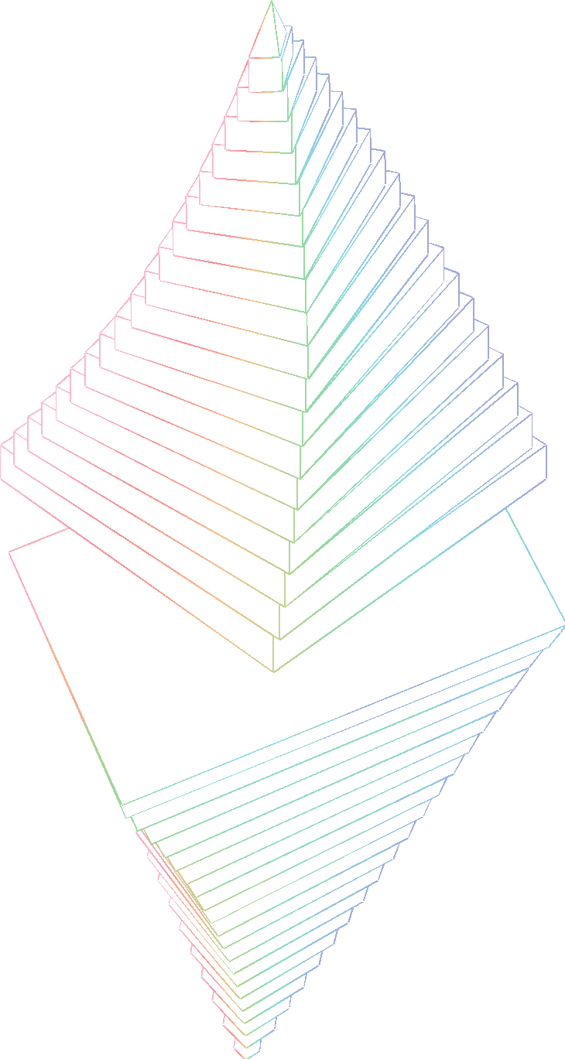

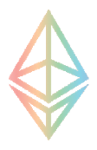
Deploying your first contract with Python
Jason Carver
Ethereum Foundation
Oct 31, 2018
devcon iv

Slide 2
Primary Goals
Install & use web3.py
Deploy new token to testnet
Trade tokens with neighbor
devcon iv
Notes:
With good hygiene

Slide 3
You should already be
Familiar with Python
Familiar with Ethereum
Comfortable at your shell
devcon iv
Notes:
With good hygiene

Slide 4
What is web3?
Your Machine
ETH Network
Python App
ipython
Nimbus
import
Parity
web3.py
Trinity
json-rpc over IPC
Turbo-Geth
Geth
devcon iv
Notes:
With good hygiene

Slide 5
Web3 with remote hosting
Your Machine
ETH Network
Python App
ipython
Nimbus
import
Parity
web3.py
Trinity
json-rpc over Websockets
Turbo-Geth
Infura node
devcon iv
Notes:
With good hygiene

Slide 6
Why Web3.py?
Rough API alignment with web3.js
Good for: console, Django, etc
Not good for: JS shops, DApps*
*except Shadowlands, someday
devcon iv
Notes:
With good hygiene

Slide 7
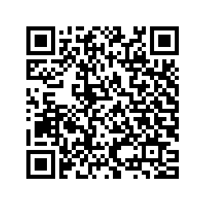
Follow Along
https://is.gd/LAEED9
Chat: gitter.im/ethereum-py/intro-workshop
devcon iv

Slide 8

This is a live-fire exercise.
Expect some snags.
devcon iv

Slide 9
Workshop Outline
Install web3.py
Connect to testnet
Fund local account
Deploy token contract
Assign an ENS name
Swap tokens
devcon iv

Slide 10
Install web3.py
devcon iv

Slide 11
Install web3.py
Install Python 3
Create virtual environment
pip install web3
devcon iv

Slide 12
Install Python 3
See if you already have it $ which python3 || echo "No python3 found, try steps below"
On GNU/Linux Debian-ish: $ sudo apt-get install python3.7-dev python3-venv python3-pip Other: build locally - see gist
On Mac $ xcode-select --install $ brew install python --with-brewed-openssl
On Windows 10 - VirtualBox with Ubuntu 18.10
devcon iv

Slide 13
Create virtual environment
Create virtual environment $ python3 -m venv ~/.venv-web3py
Alternative: use pip and virtualenv $ which pip3 || which pip || easy_install pip || sudo easy_install pip $ which virtualenv || sudo $(which pip3 || which pip) install --upgrade virtualenv $ virtualenv -p python3 ~/.venv-web3py
Enter the virtual environment $ source ~/.venv-web3py/bin/activate
Upgrade your package management & CLI infrastructure $ pip install --upgrade pip setuptools ipython certifi
devcon iv
Notes:
Explain venv, pip
Different dotfiles per env
Keep looking for mac pip installation info

Slide 14
pip install web3
Make sure to get the latest $ pip install --upgrade web3
Dependencies requires extra libraries: setup docs
Confirm installation $ ipython >>> from web3 import Web3 >>> Web3.toText(hexstr="0xf09fa684")
devcon iv

Slide 15

Workshop Outline
Install web3.py
Connect to testnet
Fund local account
Deploy token contract
Assign an ENS name
Swap tokens
devcon iv

Slide 16
Connect to testnet
devcon iv

Slide 17

Testnet options
Geth Support
No single best option for testnet. Choose your favorite tradeoff.
Ropsten
Rinkeby
Parity Support
Fast & Reliable
Kovan
devcon iv

Slide 18
Connect to testnet
Make sure you are in virtualenv $ source ~/.venv-web3py/bin/activate
Open python console $ ipython
Get web3 instance with Ropsten >>> from web3.auto.infura.ropsten import w3
Confirm connection & network >>> block = w3.eth.getBlock(4281234) >>> block.hash HexBytes('0xc34ed62271c4d9e38e2d85fbe29ca4ce5c6a609b06d0fbb7ada21de79e9ade32')
devcon iv
Notes:
Suggestion: print whole block
Quick aside about HexBytes and AttributeDict

Slide 19
Workshop Outline
Install web3.py
Connect to testnet
Fund local account
Deploy token contract
Assign an ENS name
Swap tokens
devcon iv

Slide 20
Fund local account
devcon iv

Slide 21
Fund local account
Use paper wallet
Scan key
Import private key
Confirm balance
devcon iv

Slide 22
Use paper wallet
For our purpose, a private key is 32 bytes of random data
QR code is a hex-encoded copy of that key
Paper wallets have very weak security properties
devcon iv

Slide 23
Scan key
Open webqr.com
Allow webcam usage, and hold paper wallet up to webcam
Copy the private key from the scanned result
devcon iv
Notes:
Obviously insecure

Slide 24
Import private key
Convert private key to account >>> acct = Account.privateKeyToAccount("0x34315962...") >>> acct.address "0x1234..."
devcon iv

Slide 25
Confirm Balance
Show balance in Ropsten ETH >>> balance = w3.eth.getBalance(acct.address) >>> w3.fromWei(balance, "ether") Decimal('1.337')
devcon iv

Slide 26
Workshop Outline
Install web3.py
Connect to testnet
Fund local account
Deploy token contract
Assign an ENS name
Swap tokens
devcon iv

Slide 27
Deploy token contract
devcon iv

Slide 28
Deploy token contract
Generate bytecode/ABI from source
Build deployment transaction
Sign & broadcast transaction
Confirm token balance
Verify source on Etherscan
devcon iv
Notes:
Obviously insecure

Slide 29
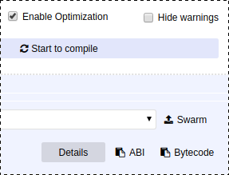
Generate bytecode/ABI from source
Copy source from this gist into remix.ethereum.org
Copy Bytecode as-is into a variable >>> bytecode = <PASTE_HERE>
Extract object field >>> token_code = bytecode['object']
Copy ABI into a string variable >>> token_abi = ''' <PASTE_HERE> '''.strip()
devcon iv
Notes:
https://github.com/OpenZeppelin/openzeppelin-solidity for quality contracts

Slide 30
Build deployment transaction
Build the contract object in preparation for deployment >>> token_deployer = w3.eth.contract(abi=token_abi, bytecode=token_code)
Build transaction >>> init = token_deployer.constructor(1000) >>> basic_txn = init.buildTransaction({'gas': 320000})
Flesh out the transaction for local signing >>> next_nonce = w3.eth.getTransactionCount(acct.address) >>> signable_transaction = dict( basic_txn, nonce=next_nonce, gasPrice=w3.toWei(3, 'gwei'), )
devcon iv

Slide 31
Sign and Broadcast Transaction
Sign transaction >>> signature_info = acct.signTransaction(signable_transaction)
Broadcast transaction >>> txn_hash = w3.eth.sendRawTransaction(signature_info.rawTransaction)
Wait for the transaction to be mined >>> receipt = w3.eth.waitForTransactionReceipt(txn_hash) # ... console freezes until transaction is mined
devcon iv

Slide 32
Confirm token balance
Get deployed contract >>> token = w3.eth.contract(address=receipt.contractAddress, abi=token_abi)
Check your balance >>> token.functions.balanceOf(acct.address).call() 1000
devcon iv

Slide 33

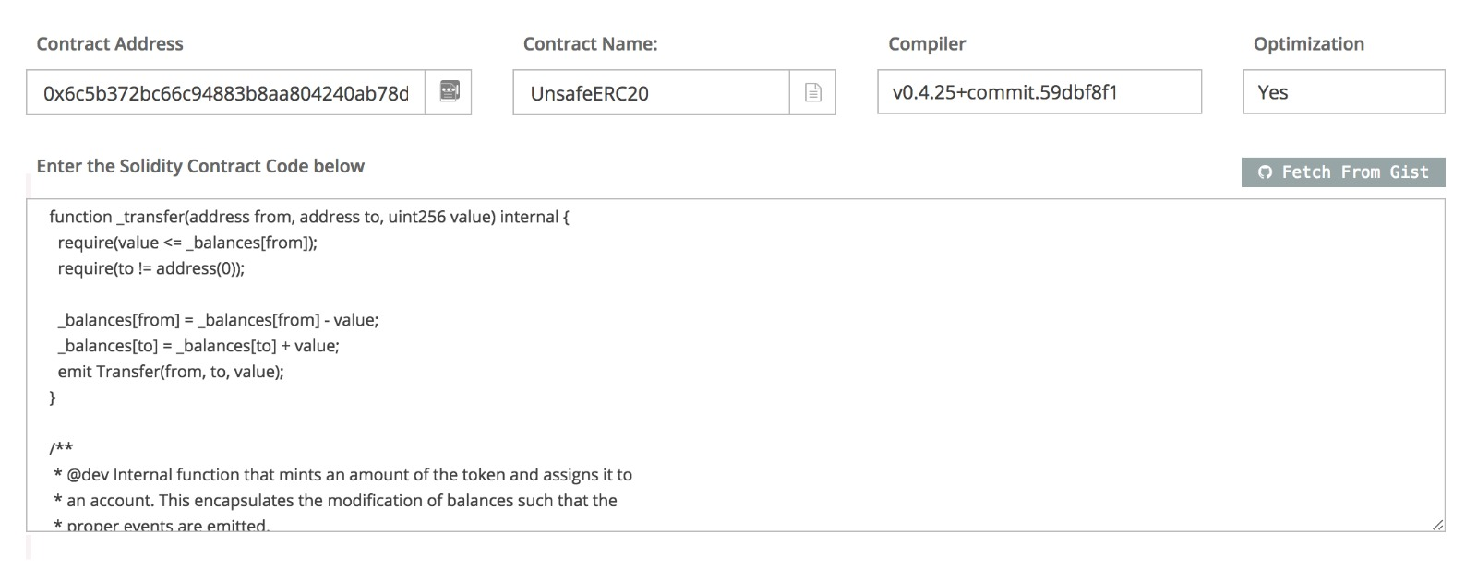
Verify source on Etherscan
Find contract at ropsten.etherscan.io/address/token.address
Copy in source
Set verification parameters
devcon iv

Slide 34

Verify source on Etherscan
3rd-party service is unfortunately the most convenient
EthPM talk tomorrow for preview of trustless verification
Until then, look for green check
devcon iv

Slide 35
Workshop Outline
Install web3.py
Connect to testnet
Fund local account
Deploy token contract
Assign an ENS name
Swap tokens
devcon iv

Slide 36
Assign an ENS name
devcon iv

Slide 37
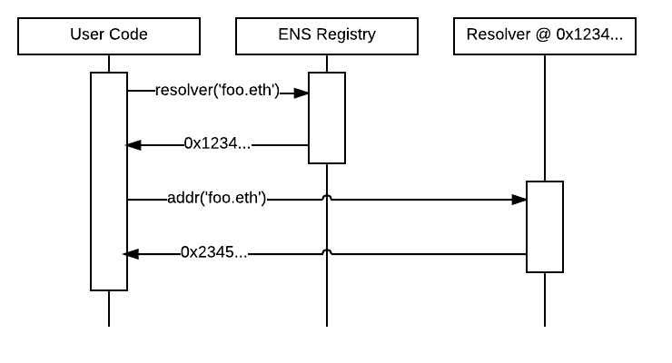
How does ENS work?
devcon iv
Notes:
Why is this in an intro? Skipping ENS is like hosting a website at an IP address
Bonus exercise for reader: point name to contract ABI

Slide 38
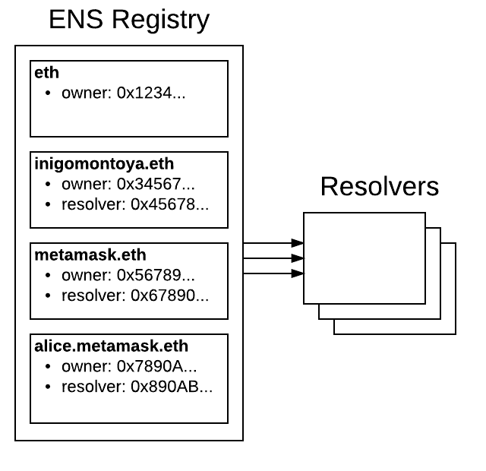
How does ENS work?
devcon iv

Slide 39
Assign an ENS name
Connect to Ropsten ENS
Acquire an ENS name
Set up resolver
Point name at contract address
Give neighbor your contract ENS name, verify address
devcon iv
Notes:
Bonus exercise for reader: point name to contract ABI

Slide 40
Connect to Ropsten ENS
Build ENS object for custom Ropsten deployment >>> from ens import ENS >>> rns = ENS( w3.providers, addr="0xbaB9717617D7e50264dE6Ee0Ef152a7CA452CF9C")
Verify connection by looking up an address >>> rns.address('jarjar.test') '0x13764E8D95F1a659E35274Cf7e8bDf7Cc05188D6'
devcon iv

Slide 41
Acquire an ENS name
Connect to giveaway registrar >>> reg_addr = rns.address('test') >>> reg_abi = [{'inputs': [{'name': 'label', 'type': 'bytes32'}, {'name': 'owner', 'type': 'address'}], 'name': 'register', 'outputs': [], 'payable': False, 'stateMutability': 'nonpayable', 'constant': False, 'type': 'function'}] >>> reg = w3.eth.contract(address=reg_addr, abi=reg_abi)
Get a name >>> my_hash = rns.labelhash('carvertoken') >>> txn = reg.functions.register(my_hash, acct.address).buildTransaction…
devcon iv

Slide 42
Set up resolver
Use public resolver for your new name >>> resolver_addr = rns.address('resolver.eth') >>> raw_ens = rns.ens._classic_contract >>> txn = raw_ens.functions.setResolver( rns.namehash('carvertoken.test'), resolver_addr, ).build...
Load resolver contract >>> resolver_abi = [{"inputs": [ {"name": "node", "type": "bytes32"}, {"name": "addr", "type": "address"}], "constant": False, "name": "setAddr", "outputs": [], "stateMutability": "nonpayable", "payable": False, "type": "function"}] >>> resolver = w3.eth.contract(address=resolver_addr, abi=resolver_abi)
devcon iv

Slide 43
Point name at contract
In public resolver, point name at contract >>> namehash = rns.namehash('carvertoken.test') >>> txn = resolver.functions.setAddr(namehash, token.address).buildTr...
Confirm that your name now resolves to your contract >>> rns.address('carvertoken.test') == token.address True
devcon iv

Slide 44
Workshop Outline
Install web3.py
Connect to testnet
Fund local account
Deploy token contract
Assign an ENS name
Swap tokens
devcon iv

Slide 45
Swap tokens
devcon iv

Slide 46
Swap tokens with neighbor
Get ENS name for local account
Send token to neighbor's local account
Verify token balance from neighbor
Transaction "cancellation"
Take-home exercise: Atomic Swap
devcon iv

Slide 47
Get ENS name for local account
Get name from registrar, this time just "<username>.test"
Set resolver for new name to the public resolver
On the resolver contract, set address to your local account >>> namehash = rns.namehash('carver.test') >>> resolver.functions.setAddr(namehash, acct.address).buildTransaction...
devcon iv

Slide 48
Send token to neighbor
Get ENS name to neighbor local account
Look up neighbor's local account name >>> neighbor_addr = rns.address('neighbor.test')
Send random number of tokens to neighbor >>> import random >>> amt = random.randint(0, 9) >>> txn = token.functions.transfer(neighbor_addr, amt).buildTransaction…
devcon iv

Slide 49
Verify token balance from neighbor
Get neighbor's token address >>> neighbor_token_addr = rns.address('neighbortoken.test')
Load neighbor's token contract >>> neighbor_token = w3.eth.contract(neighbor_token_addr, abi=token.abi)
Check received tokens >>> neighbor_token.functions.balanceOf(acct.address).call() 3 # check with neighbor to confirm how many tokens they sent
devcon iv

Slide 50
Transaction "cancellation"
Send transaction with low gas price >>> txn = token.functions.transfer(neighbor_addr, 20).buildTransaction… >>> nonce = w3.eth.getTransactionCount(acct.address) >>> price = 1
Confirm on Etherscan that transaction is pending
Send new transaction with same nonce & higher gas price >>> signature_info = acct.signTransaction(dict( nonce=nonce, # same nonce as pending transaction above gasPrice=w3.toWei(5, 'gwei'), # gas price must be at least 10% higher to=acct.address, value=0, gas=21000, ))
devcon iv

Slide 51
Take-home exercise: Atomic Swap
Trade tokens without worry of being cheated
Variant: swap tokens for ether
There can be a few subtleties to get this swap correct
See decentralized exchanges for a general solution
devcon iv
Notes:
It's fairly common to wrap ether into an ERC20 so that you don't have to deal with the variant as a special case.
Some example decentralized exchanges:
Gnosis DutchX
0x
IDEX

Slide 52
Workshop Outline
Install web3.py
Connect to testnet
Fund local account
Deploy token contract
Assign an ENS name
Swap tokens
devcon iv

Slide 53

You feel more confident in your spell-casting skills
devcon iv

Slide 54
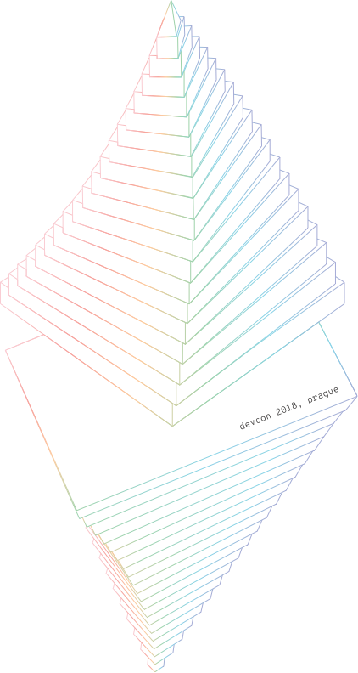
Huge thank you to the volunteers!
Johns Beharry
Dylan Wilson
Bryant Eisenbach
Christoph Burgdorf
Nick Gheorghita
Keri Clowes
devcon iv

Slide 55
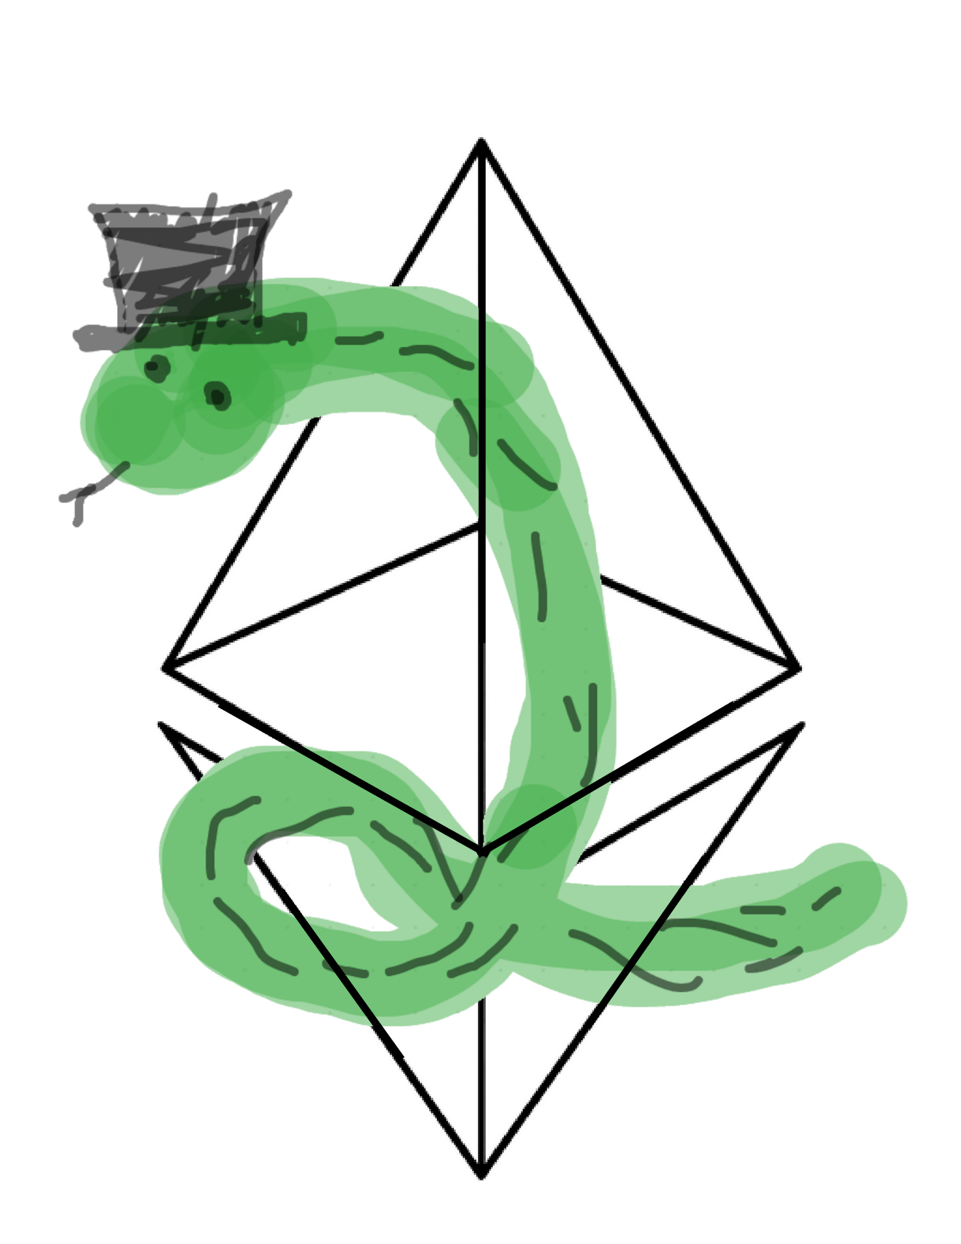
Thank you!
Comments or suggestions for next time?
Open a ticket on: github.com/ethereum/web3.py/issues
Jason Carver @carver on github
devcon iv

Slide 56
Reference Slides
devcon iv

Slide 57
Getting your hex account address to your neighbor
Print your local address >>> acct.address '0x1234...'
Open webqr.com/create.html
Copy address into field and click Create
Have neighbor open webqr.com and scan it from your QR code >>> neighbor_addr = "0xaBcD..."
devcon iv

Slide 58
Connect to Infura over HTTPS
Register with Infura for API key
Set API key & https environment variables $ export WEB3_INFURA_API_KEY="l33th4x0r" $ export WEB3_INFURA_SCHEME="https"
Launch ipython $ ipython
Load configured web3 instance >>> from web3.auto.infura.ropsten import w3
devcon iv

Slide 59
Create local Ethereum account
Create a local private key >>> from eth_account import Account >>> acct = Account.create('smash keyboard for bonus entropy in private key')
Congratulations, you have an account at >>> acct.address '0x0123456789abcdef...'
devcon iv
Notes:
Why local key? because Infura
Private keys are stored in memory, or if you like, written to file. Both of these at risk on your machine.
See more about private keys: https://web3py.readthedocs.io/en/stable/web3.eth.account.html

Slide 60
Verify local account balance
Check out some eth-account Account APIs: >>> help(acct) | encrypt(self, password) | signHash(self, message_hash) | signTransaction(self, transaction_dict) # <- Today we'll use this one
Check balance >>> w3.eth.getBalance(acct.address) 0
Naturally, account is empty
devcon iv
Notes:
Suggestion: print whole block
Quick aside about HexBytes and AttributeDict

Slide 61
Fund local account: Android
Import private key from paper wallet
Make QR code for local address
Send paper Ropsten ETH to local address
devcon iv

Slide 62
Import private key from paper wallet
Sidebar -> Keys -> (*) ECDSA
Scan QR code
Switch network to Ropsten
Sidebar -> Accounts -> Choose new account
Confirm ETH balance on mobile
devcon iv

Slide 63
Make QR code for local address
Display local address again >>> acct.address '0x8c9E19726f9a30aDE3B4b7d371761eA7dA35c1C5'
Visit webqr.com/create.html
Paste in address without quotes, like: [ 0x8c9E19726f9a30aDE3B4b7d371761eA7dA35c1C5 ]
Click Create
devcon iv
Notes:
Reminder:
magenta means that you will have to type in something different from what you see
yellow means that you will see a different result than what's on the slide

Slide 64
Send paper Ropsten ETH to local address
In wallet view, click green arrow in top right
Under To, click camera to scan QR code for local address
Send 0.5 ETH
Press green key circle
Confirm ETH at local address >>> balance = w3.eth.getBalance(acct.address) >>> w3.fromWei(balance, 'ether') Decimal('0.5')
devcon iv

